Slide 1
FINAL PROJECT CIT COURSE
LEARNING MICROSOFT WORD AND EXCEL
Alishba adil

Slide 2
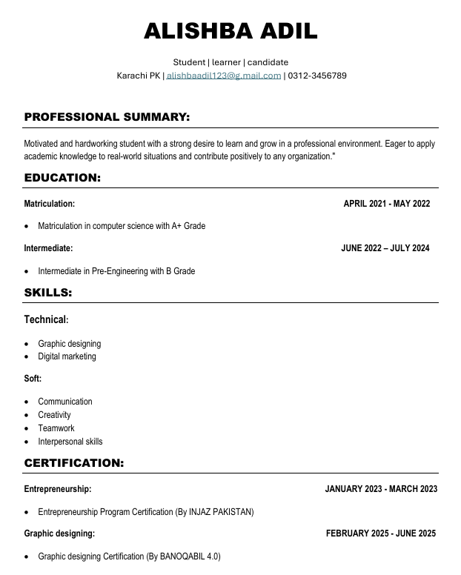
RESUME:
I made my resume using Microsoft Word. First, I opened Word and chose a Blank template. Then I filled in my personal details, work experience, education, and skills.
I used bullet points, clear fonts, and bold headings to keep it neat and professional. After checking for any mistakes, I saved it as a PDF to share easily.
It was quick and simple, and Word made it look great. Thank you!

Slide 3
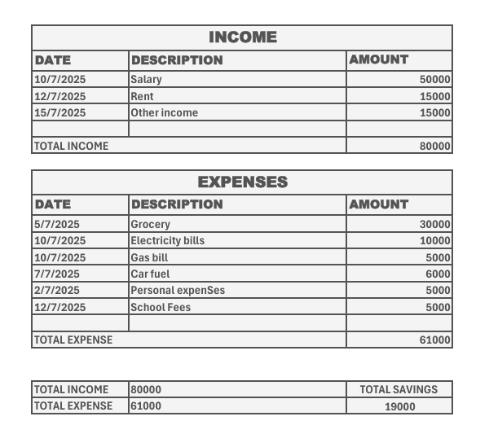
BUDGET SPREAD SHEET: I created my personal budget sheet using Microsoft Excel to help track my income and expenses. I started by listing all my income sources and expenses in a table. Then, I used the SUM formula to automatically calculate the total income, total expenses, and balance. Excel made it easy to organize my finances and visualize where my money goes. Thank you!

Slide 4
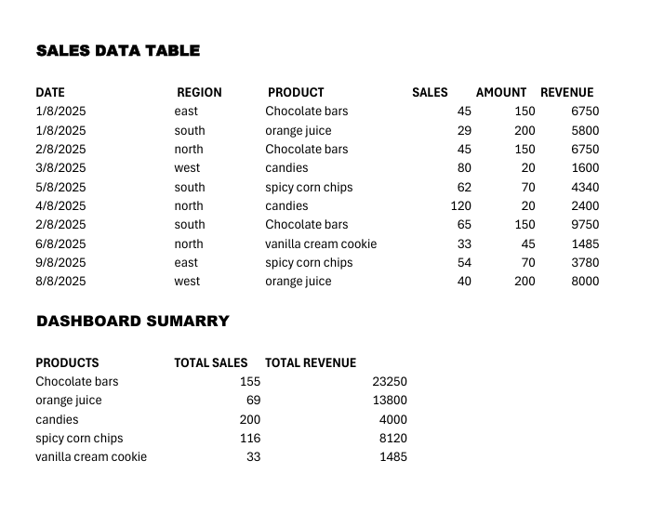
Excel Spreadsheet for Product Sales & Revenue:
I created an Excel spreadsheet to
track the products I sell,
their prices, and quantities sold.
I calculated revenue for each product
by multiplying sales and price using a
formula like =B2*C2.
Then, I built a simple dashboard showing
total sales and total revenue using the
SUM formula
(e.g., =SUM(D2:D10)). This helps me quickly see overall performance and earnings.

Slide 5
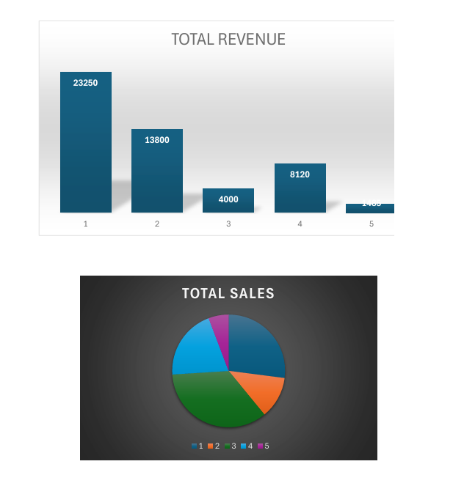
Charts for Sales and Revenue Analysis:
After creating the spreadsheet, I added a bar graph to show sales for each product and a pie chart to display each product’s contribution to total revenue. These visuals make the data easier to understand at a glance and help in comparing product performance.

Slide 6
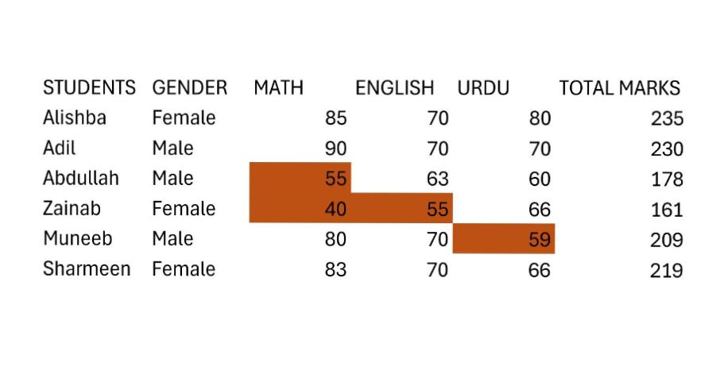
Conditional formatting in Excel:
I applied conditional formatting in an Excel sheet to highlight student marks. A rule was set that if any student scored below 60, the cell would automatically turn red. This made it easy to quickly identify the weak students and improved the clarity of data analysis.

Slide 7
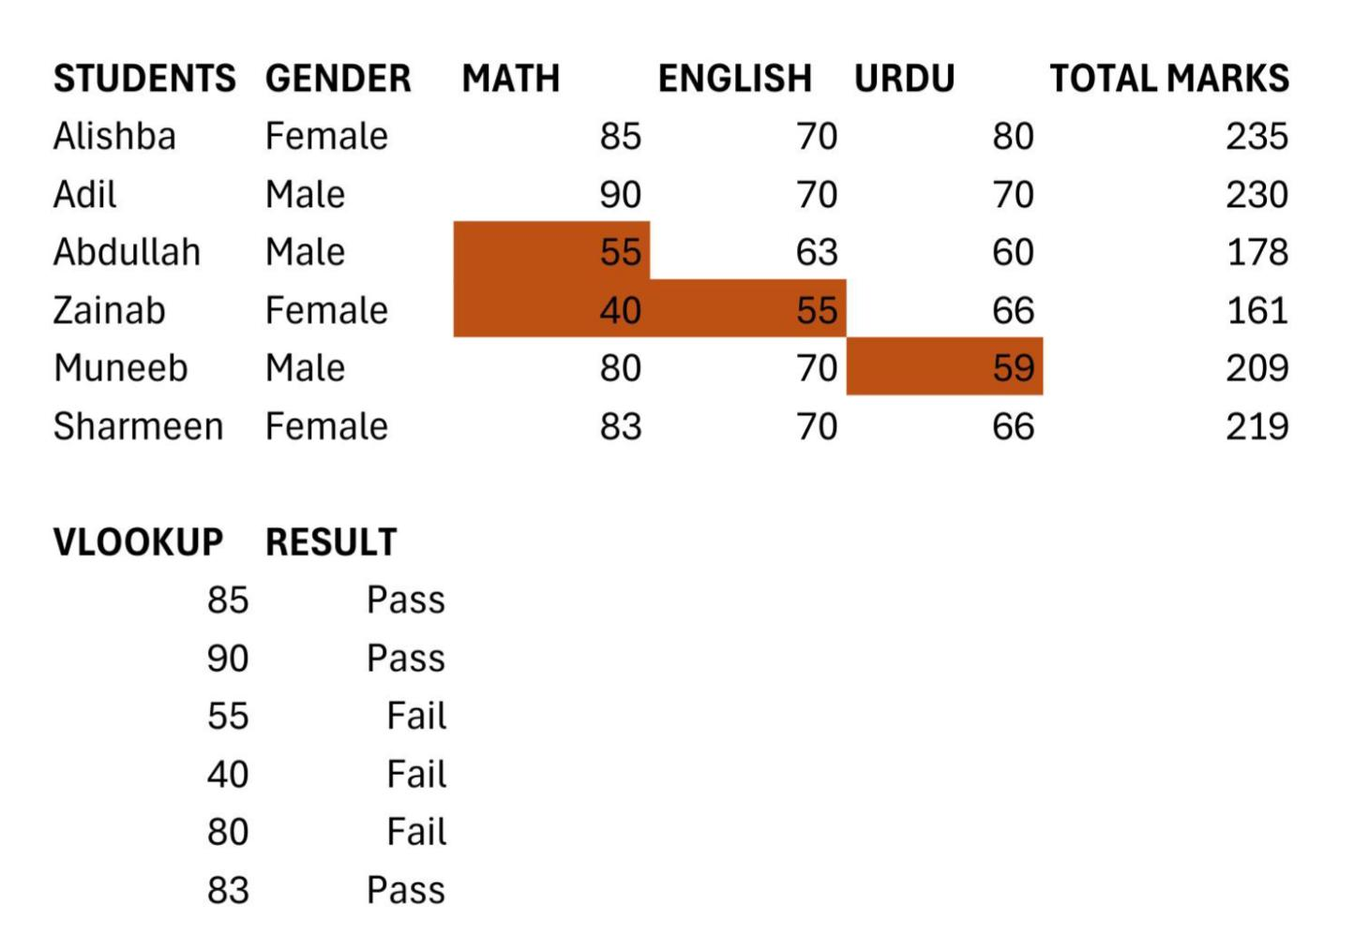
Using VLOOKUP and IF formula in excel:
In my Excel sheet, I applied the VLOOKUP formula to find students’ Mathematics marks from a given table by matching their gender. Along with this, I used the IF formula to determine their results, where a student scoring 180 or more is marked as Pass and those below 180 are marked as Fail. This combination of VLOOKUP and IF made it easy to quickly retrieve marks and display clear results.

Slide 8
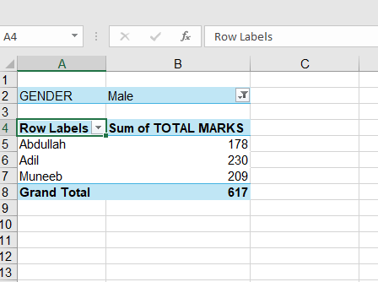
Applying pivot table in excel:
I have demonstrated the process of creating a pivot table in my Excel sheet. I first selected the data range, then inserted a pivot table through the "Insert" tab. After choosing the desired fields for rows, columns, and values, I customized the pivot table to summarize the data effectively. A screenshot of the final pivot table is included to showcase the result

